Slide 1
Optimal Energy Storage System Operation for Peak Reduction
Daisuke Kodaira, Sekyung Han
Kyungpook National University, Korea.

Slide 2
Project of peak shaving using Energy Storage System
Battery prices come down
Recover the investment
System configuration:
・Peak shaving on distribution network (22.9kV) by network operator
・Two Energy Storage Systems (battery) are installed in the field
・ESSs are controlled by remote. The schedule is determined by the network operator 24 hours ahead

Slide 3
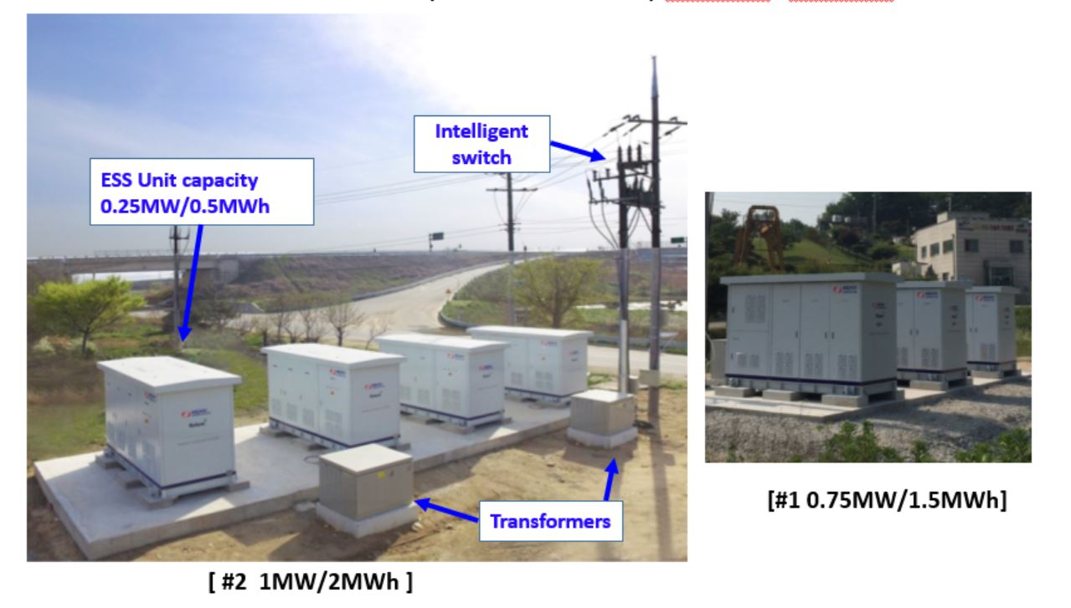

Slide 4
The steps of peak shaving
Load Prediction
ESS optimization
Evaluation
Load Prediction
- How much is the peak tomorrow?
- When will the peak comes tomorrow?
ESS optimization
- What is the best schedule of ESSs?
Evaluation
- How much we shaved the peak?

Slide 5

Load Prediction - problem
The prediction is not always reliable….
MW
“Prediction tells us
we don’t need to
operate ESS for peak”
Observed Load
Load on feeder
Line capacity
10
6
Predicted Load
0
1
2
3
････
23
hour
Now
ESS cannot reduce the peak appropriately
in case the prediction has error

Slide 6
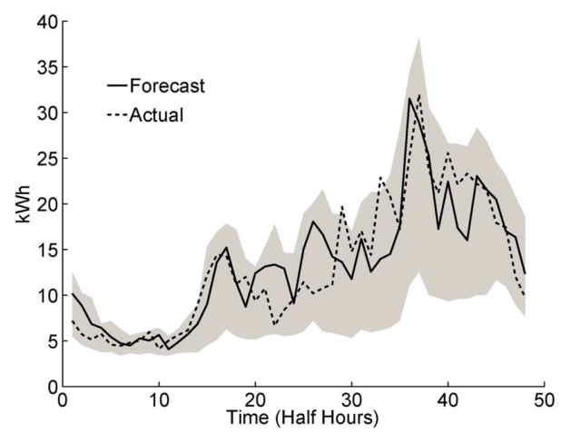
Load Prediction - solution
The concept of probability is necessary to evaluate the risk
Probabilistic Interval (PI)
“Prediction tells us
the load falls into gray zone with 95% probability”
Line capacity
Prediction with PI is proposed by many existing studies
How can we utilize the PI for ESS control?

Slide 7
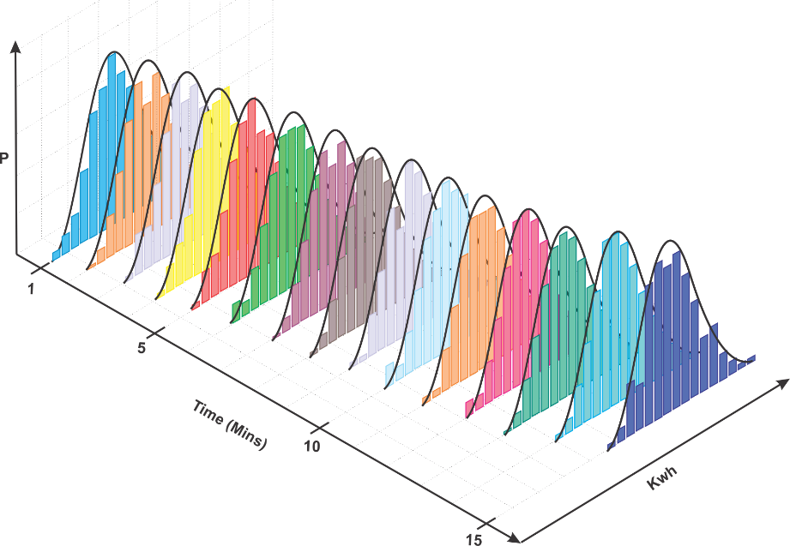
Load Prediction
Probability
Load [MW]
0
3
5
8
････
Probability
Load [MW]
5
8
11
14
････

Slide 8


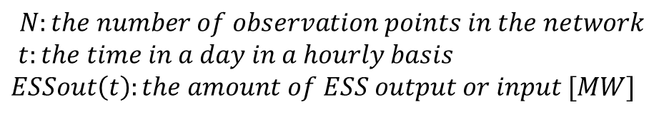

ESS optimized schedule
am0:00 ~ am1:00
t ~ t+1
Probability
Probability
95% PI
Lower
boundary
Upper
boundary
95% PI
MW
MW
1
4
6
10
$$B_{lower}(t,n)$$
$$B_{upper}(t,n)$$
5
$$arg\min_{ESSout(t)}{{α\left\|B_{upper}\left(t,n\right)−ESSout(t),t=1..24,n=1….N\right\|}_{∞}+β\sum_{t=1}^{24}{(ESS{out\left(t\right)}^{2})}}$$
$$where$$
$$N:the number of observation points in the network$$
$t:the time in a day in a hourly basis$
$ESSout\left(t\right):the amount of ESS output or input [MW]$

Slide 9

How can we build Prediction Intervals (PIs)?
Now, Let’s assume we are ESS operator. We have to select the one of the prediction algorithm and boundaries. How can we chose one of them?
My algorithm tell the boundary containing 100% data set.
But the width is wider.
My algorithm tell the boundary containing 90% data set.
The width is smaller.

Slide 10
Various PIs example
Past Load and PIs
Chebyshev
Confidence Interval
Sample base
Each PI has another boundaries. Sample base shows the most optimistic one and Chebyshev shows the most pessimistic one

Slide 11


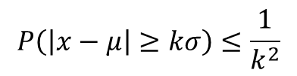


Construction of PIs
Sample base
Pick the 5% and 95% data in ascending data as the boundaries.
1 2 3 4 5 6 7 8 9 10
$$lower boundary=10∗0.05→1$$
$$upper boundary= 10∗0.95→10$$
Confidence Interval
The data is assumed to follow the normal distribution, calculate 95% CI
$$lower boundary= μ−2σ$$
$$upper boundary= μ+2σ$$
Chebyshev
Chebyshev’s inequality ensure the certain percentage of data lays in certain range
$$P\left(\left|x−μ\right|≥kσ\right)≤\frac{1}{k^{2}}$$

Slide 12
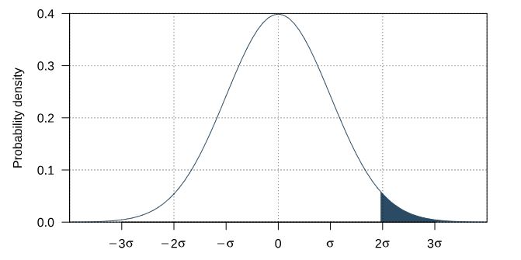
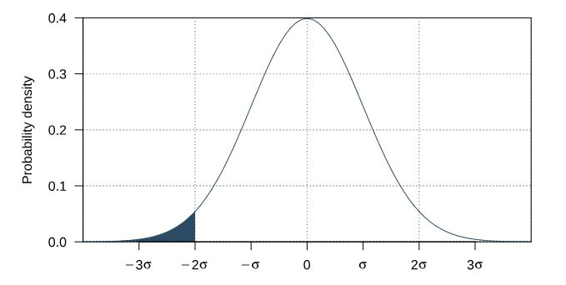
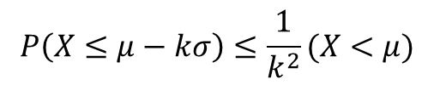
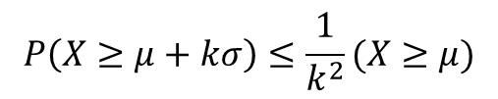
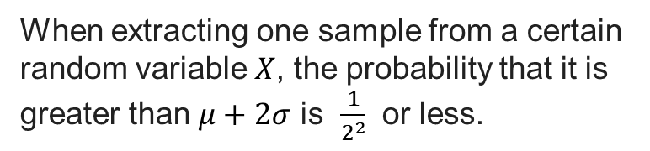
Construction of PIs - Chebyshev
Chebyshev’s inequality
Chebyshev’s inequality ensure the certain probability as the sample lays in certain range
$$P\left(X≥μ+kσ\right)≤\frac{1}{k^{2}}(X≥μ)$$
$$P\left(X≤μ−kσ\right)≤\frac{1}{k^{2}}(X<μ)$$
When extracting one sample from a certain random variable $X$, the probability that it is greater than $μ+2σ$ is $\frac{1}{2^{2}}$ or less.

Slide 13
Error distribution and PIs
Deterministic prediction
Deterministic prediction
Deterministic prediction
・・・・・
Day 1
Day 2
Day 3
Error distribution
for 0am~1am
Probability
Window
Confidence Interval
Chebyshev
Error rate[%]
Each hour has error distribution respectively
The error is obtained by the past data prediction

Slide 14


PI evaluation - CWC
There are general criterion – The coverage-width-based criterion (CWC)
1. How wide the boundary is?
- Normalized mean prediction interval width (NMPIW)
2. How many data falls into the boundary?
The PI coverage probability (PICP)
Ex) Nominal boundary = 90%
Actual boundary(PICP) = 89%
Smaller CWC is better score.

Slide 15
PIs for one day prediction
Let’s assume we predict tomorrows load with PIs
a) Sample base
(b) confidence interval
(c) Chebyshev
 | Sample | CI | Chebyshev
Coverage rate | 57% | 79% | 100%
Normalized PI width | 0.25 | 0.4 | 0.79
CWC score | 3.2E+12 | 1674 | 0.78
Which PI derives the best performance on the peak reduction?

Slide 16
ESS schedules – various PIs
a) Sample base
ESS discharges around 8am and 11pm

Slide 17
ESS schedules – various PIs
b) confidence interval
ESS discharges around 8am and 11pm as window case

Slide 18
ESS schedules – various PIs
c) Chebyshev
ESS discharge focuses on only around 8am
because of the highest peak around 8am

Slide 19
Operation result for one day
Operation result with sample base PI
 | sample | CI | Chevshyev
Observed load [MW] | 6.5
Adjusted Observed load [MW] | 6.0 (-7.6%) | 6.0 (-7.6%) | 6.8 (+4.6%)
Sample base and CI can reduce the peak properly, but
Chevshyev increases the peak from 6.5MW to 6.8MW

Slide 20
Operation result for one year
Yearly peak reduction on each PIs
reduction
reduction
reduction
a) Sample base
(b) Confidence interval
(c) Chebyshev
 | Sample | Confidence interval | Chevshyev
Median of Reduction [MW] | -0.13 | -0.09 | +0.06
Average of Reduction [MW] | -0.21 | -0.19 | +0.008
The highest peak in a year [MW] | 10.05 -> 9.88(-1.6%) | 10.05 -> 9.82(-2.2%) | 10.05 -> 9.96(-0.89%)
Window PI derives the best performance through a year
even though the its CWC score is the worst among 3 methods

Slide 21
Operation result for one year
reduction
reduction
reduction
a) Sample base
(b) Confidence interval
(d) ideal operation
 | Sample base | Confidence interval | No error prediction (ideal operation )
Median of Reduction [MW] | -0.13 | -0.09 | -0.81
Average of Reduction [MW] | -0.21 | -0.19 | -0.76
The highest peak in a year [MW] | 10.05 -> 9.88(-1.6%) | 10.05 -> 9.82(-2.2%) | 10.05 -> 8.91(-11.3%)
Why the highest peak is not reduced as ideal operation by the proposed PIs?

Slide 22
The highest peak in a year (Confidence interval case)
How does the original highest peak change by ESS operation?
Peak reduced 10.5 -> 9.03 (-1.47MW) 14% reduction (ideal reduction is 15%)
All observed data lay inside of PI
During 0:00-1:00, the prediction is underestimated but PI covers the error properly
During 7:00-9:00, load is mitigated because of the high upper CI(risk assessment)
During 23:00-24:00, peak is properly reduced

Slide 23
The highest peak in a year (Confidence interval case)
How is the new highest peak after ESS operation?
Peak increased 9.35 -> 9.82 (+0.47MW) 4.7% increase
During 0:00-1:00, observed data is out of the PI (Prediction error) 5% phenomenon?
During 9:00-10:00, Upper CI is large and it is mitigated (Risk assessment)

Slide 24
Discussion3: Problem statement
peak
off-peak
Originally, objective function doesn’t care the off-peak duration. (That’s why PI increased by ESS operation during 0-1am)
-> What if we consider the off-peak duration too?

Slide 25
Discussion3: Concept of new objective function
MW
Prediction
Case1
Case3
Load on feeder [MW]
Case2
Case1
hour
Actual
Load on feeder [MW]
hour

Slide 26

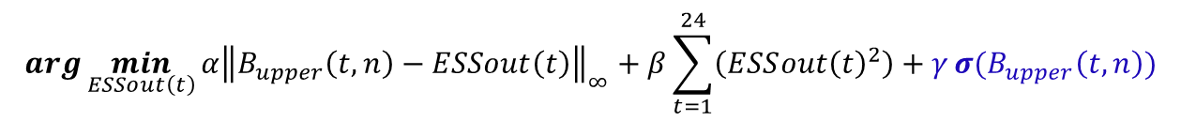

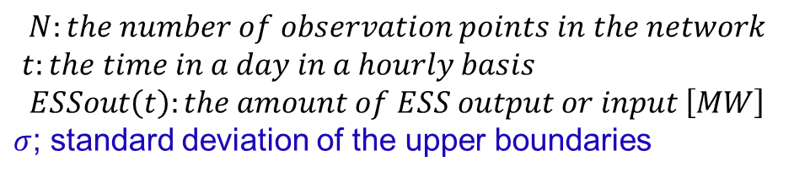


Discussion3: Modified objective function
am0:00 ~ am1:00
t ~ t+1
Probability
Probability
95% PI
Lower
boundary
Upper
boundary
95% PI
MW
MW
1
4
6
10
$$B_{lower}(t,n)$$
$$B_{upper}(t,n)$$
5
$$arg\min_{ESSout\left(t\right)}{{α\left\|B_{upper}\left(t,n\right)−ESSout\left(t\right)\right\|}_{∞}+β\sum_{t=1}^{24}{\left(ESS{out\left(t\right)}^{2}\right)}+γ}σ(B_{upper}\left(t,n\right))$$
$$\left(t=1..24,n=1….N \right)$$
$$where$$
$$N:the number of observation points in the network$$
$t:the time in a day in a hourly basis$
$$ESSout\left(t\right):the amount of ESS output or input \left[MW\right]$$
$σ$; standard deviation of the upper boundaries
Notes:
・Intuitively, we want to flat the PI. The “Flat” can be realized by minimizing the standard deviation (or variance) of PI from 0-24. The blue term is new variable to flat the PIs.

Slide 27
Discussion3: operation result vs previous Objective function
Previous objective function |  | Sample base | Confidence interval | Chevshyev | No error prediction
Median of Reduction [MW] |  | -0.13 | -0.09 | +0.06 | -0.81
Average of Reduction [MW] |  | -0.21 | -0.19 | +0.008 | -0.76
The highest peak in a year [MW] |  | 10.05 -> 9.88 (-1.6%) | 10.05 -> 9.82 (-2.2%) | 10.05 -> 9.96 (-0.89%) | 10.05 -> 8.91 (-11.3%)
Modified objective function | Deterministic Prediction | Sample | Confidence interval | Chevshyev | No error prediction
Median of Reduction [MW] | -0.43 (-7.2%) | -0.56 (-9.9%) | -0.58 (-9.9%) | -0.44 (-7.48%) | -0.81 (-12.1%)
Average of Reduction [MW] | -0.47 (-6.8%) | -0.60 (8.9%) | -0.61 (-9.1%) | -0.47 (-5.78%) | -0.76 (-11.8%)
The highest peak in a year [MW] | 10.05 ->9.97 (-0.8%) | 10.05 -> 9.54 (-5.1%) | 10.05 -> 9.42 (-6.2%) | 10.05 -> 9.79 (-2.5%) | 10.05 -> 8.91 (-11.3%)
Notes:
*With modified objective function, the amount of reduction improved in terms of all perspectives (average, median and the highest peak).
*On the top of that, I proofed using PI realizes more reduction than using deterministic prediction. The PI (boundaries based on historical error) mitigates the negative affect of the prediction error to seek the optimal ESS schedule

Slide 28
CWC vs peak reduction
What I expected
There are no obvious relationship between CWC and peak reduction

Slide 29
CWC vs peak reduction
What I expected
What I expected
There are no obvious relationship between CWC and peak reduction

Slide 30
Appendix

Slide 31
Network topology and parameters
Line Capacity is 10MW(max cap)
CB to ESS #1 : 5,824m
ESS #1 to ESS #2 : 9,598m
ESS #2 to end of line : 7,428m
ESS #1
ESS #2
PCS Cap : 1MW
ESS Cap : 2MWh
PCS Cap : 1MW
ESS Cap : 2MWh
Will be install at this point
Already installed

Slide 32
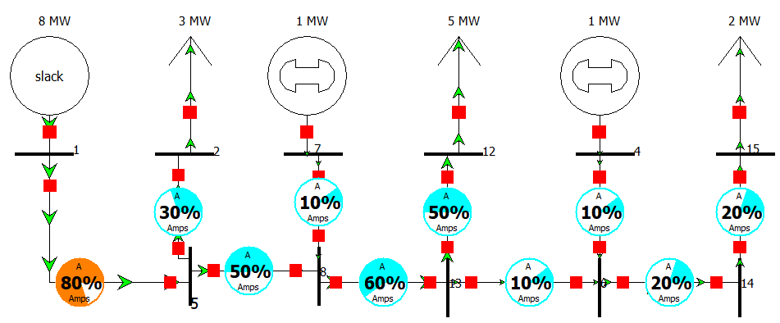
How to flow form each ESS and substation
This power flow is a example.
The algorithm evaluates the criticalness at 5 parts of feeder
A) Between substation and load1
B) Between load1 and ESS#1
C) Between ESS#1 and load2
D) Between load2 and ESS#2
E) Between ESS#2 and load3
80
Amount of Power flow
60
2)
50
1)
10
20
ESS#1
ESS#2
A)
B)
C)
D)
E)

Slide 33
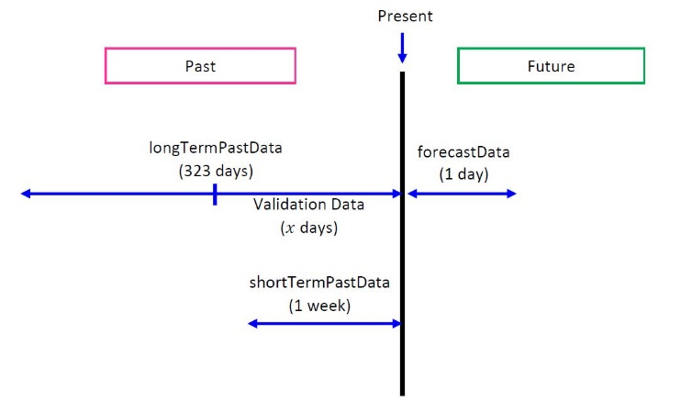
Input Data structure
longTermPastData: past load and predictors
forecastData: predictors for load forecasting
(The data measured immediately before will be utilized here in this project)

Slide 34
Input Dataset
Building Index | Year | Month | Day | Hour | Quarter | P1(DayOfWeek) | P2(Holiday) | P3(Temp) | P4(Radiation)
1 | 2018 | 6 | 29 | 11 | 1 | 5 | 4 | 29 | 2
1 | 2018 | 6 | 29 | 11 | 2 | 5 | 4 | 29 | 2
1 | 2018 | 6 | 29 | 11 | 3 | 5 | 4 | 29 | 2
1 | 2018 | 6 | 29 | 12 | 0 | 5 | 4 | 29 | 2
1 | 2018 | 6 | 29 | 12 | 1 | 5 | 4 | 29 | 2
Data classification | Variable Name | Value
Time data (Time data showing the estimated period you specify) | BuildingIndex | Numbers indicates the buildings or sites where the system is deployed E.g. 1,2,…, etc.
 | Year | A 4-digit number representing the year E.g. 2017, 2018, etc.
 | Month | A double digit representing the month E.g. 01, 02, 03, 04, 05, 06, 07, 08, 9, 10, 11, 12
 | Day | A double-digit number representing the day E.g. 01, 02, …, 30, 31
 | Hour | A double-digit number representing time E.g. 0, 1, …, 22, 23, 24
 | Quarter | A one-digit number representing minutes E.g. 00 minutes -> 0, :15 minutes - > 1, :30 minutes -> 2, :45 minutes -> 3

Slide 35
Input Dataset
Building Index | Year | Month | Day | Hour | Quarter | P1(DayOfWeek) | P2(Holiday) | P3(Temp) | P4(Radiation)
1 | 2018 | 6 | 29 | 11 | 1 | 5 | 4 | 29 | 2
1 | 2018 | 6 | 29 | 11 | 2 | 5 | 4 | 29 | 2
1 | 2018 | 6 | 29 | 11 | 3 | 5 | 4 | 29 | 2
1 | 2018 | 6 | 29 | 12 | 0 | 5 | 4 | 29 | 2
1 | 2018 | 6 | 29 | 12 | 1 | 5 | 4 | 29 | 2
Data classification | Variable Name | Value
Predictors | Tempreature | The temperature measured by the sensors E.g. 20.0, 19.5,…, etc.
 | Radiation | The sun radiation measured by the sensors E.g. 2, 3, etc.
Before we get the measurement data, we prepare the past data from web.
As the sensors collect the data, the past data from web is updated to measurement data

Slide 36





Implementation & libraries
On Windows
matlab
On Linux
Source is written by matlab on windows.
Our java libraries work on the windows environment and Linux environment.

